Slide 1
Write good code

Slide 3
Why should you care? An example.

Slide 4
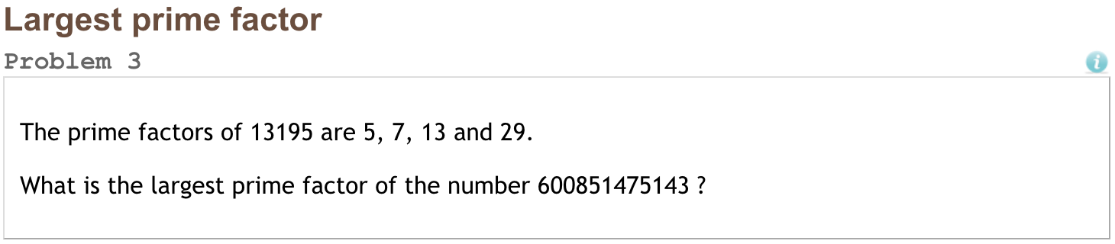

Slide 5
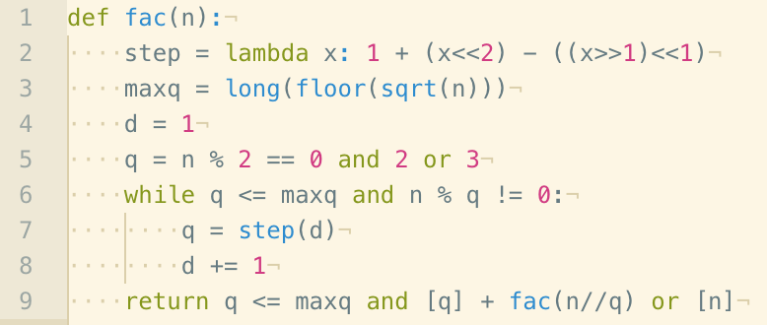
“Here! I’ve solved it.”
Source: Rosetta Code

Slide 6
How does this function work?
What are those less-than signs doing??
What does the variable d do?
What kinds of input can it take?
What kinds of output does it produce?
What if we needed to modify this function somehow?

Slide 7
Why should you care?
The ultimate goal of all Data Science is communication.
This doesn’t mean that all Data Science achieves that goal.

Slide 8
Why should you care?
The ultimate goal of all Data Science is communication.
Between
You and the engineers who will deploy and maintain your models.

Slide 9
Why should you care?
The ultimate goal of all Data Science is communication.
Between
You and the engineers who will deploy and maintain your models.
You and other Data Scientists who will interact with and maintain your code.

Slide 10
Why should you care?
The ultimate goal of all Data Science is communication.
Between
You and the engineers who will deploy and maintain your models.
You and other Data Scientists who will interact with and maintain your code.
You and your bosses/company leadership/whomever you will communicate results to.

Slide 11
Why should you care?
The ultimate goal of all Data Science is communication.
Between
You and the engineers who will deploy and maintain your models.
You and other Data Scientists who will interact with and maintain your code.
You and your bosses/company leadership/whomever you will communicate results to.
You and yourself, months from now, when you will need to revisit this code.

Slide 12
Why should you care?
The ultimate goal of all Data Science is communication.
Good code isn’t written for a computer to run.
Good code is written for other people to understand.

Slide 13
How do we write good code?

Slide 14
How do we write good code?
Use a style guide.
Seriously, click on one of the links below and read. Refer back to it.
Recommended: Google Python Style Guide
Others
PEP8: the official Python Style Guide (not maintained)
PEP257: Docstring Style Guide
nasa

Slide 15
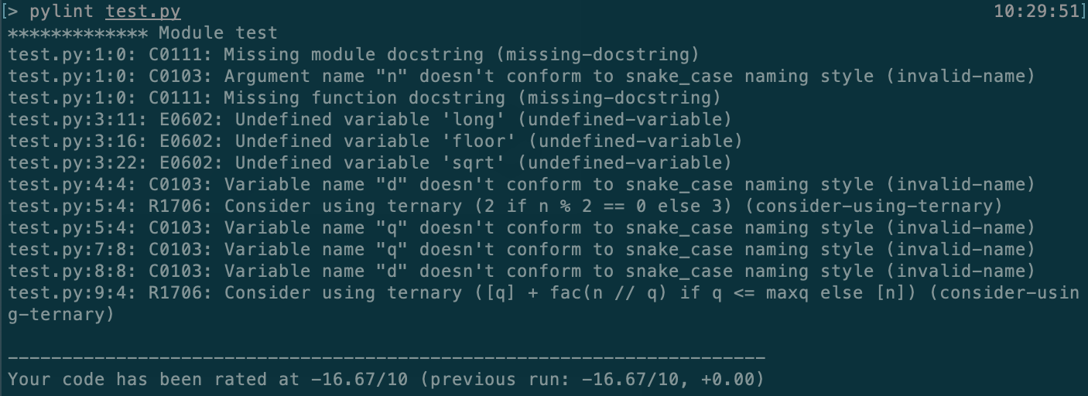
How do we write good code?
Use a style guide.
Use a Linter.
Linters scan your code and mark any problems. It’s like spell check for code.
Great for catching errors as well as style problems.
Pylint is recommended by Google Style Guide but there are many others.
Can be run from command line

Slide 16
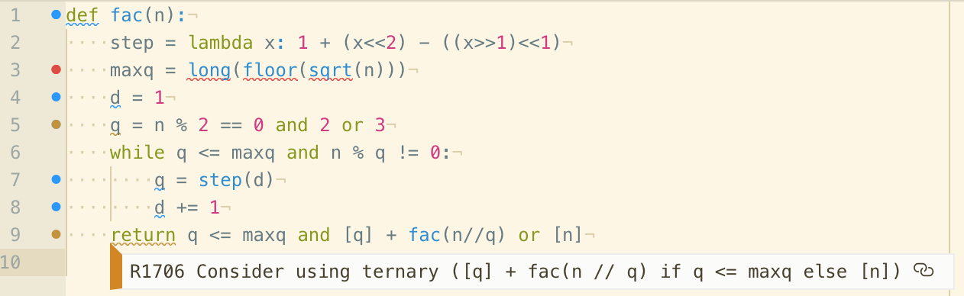
How do we write good code?
Use a style guide.
Use a Linter.
Linters scan your code and mark any problems. It’s like spell check for code.
Great for catching errors as well as style problems.
Pylint is recommended by Google Style Guide but there are many others.
Can be run from command line
Find a plug-in for your favorite text editor to get feedback as you code.

Slide 17
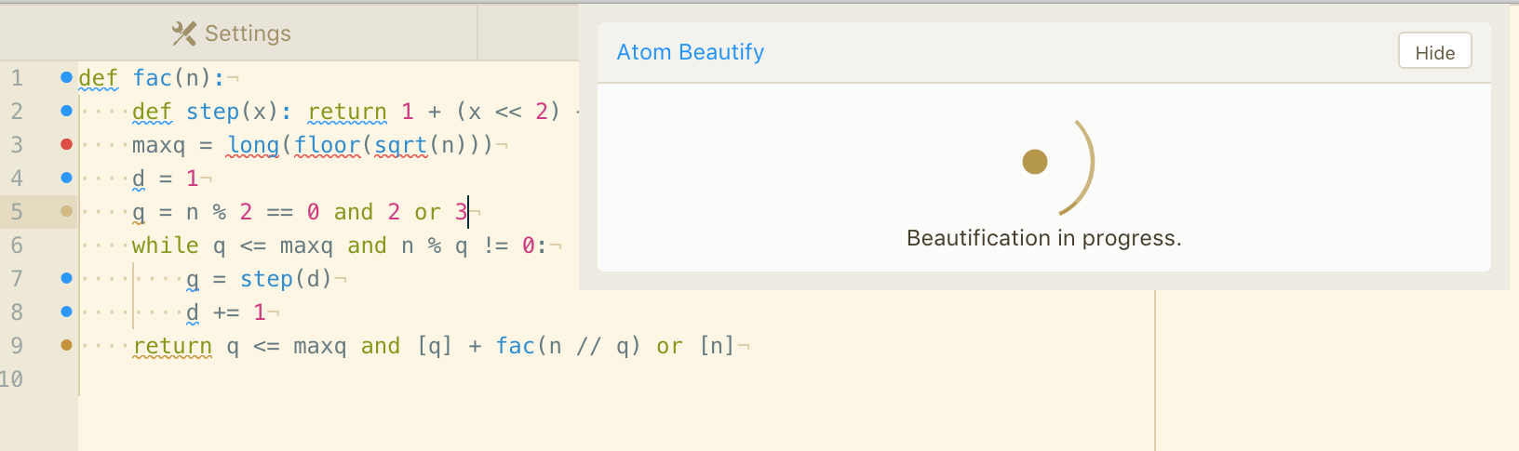
How do we write good code?
Use a style guide.
Use a Linter.
Use a Beautifier.
A beautifier (aka formatter) automatically makes changes to your code to improve style.
Only makes “safe” changes that will not affect code. You’ll have to rename the variables.
Can be used from command line or as a plug-in.

Slide 18
Style Guide Highlights
Let’s dig into the Google Style Guide for a second.

Slide 19
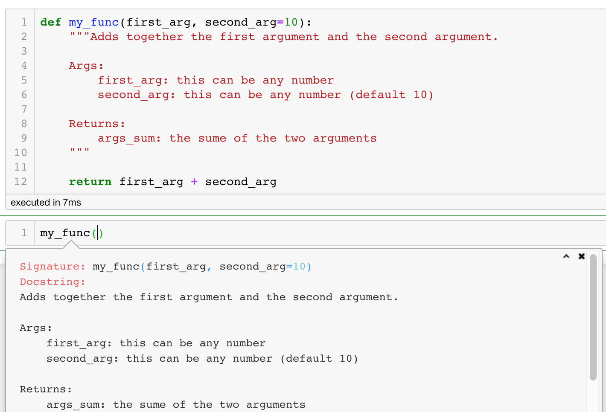
Style Guide Highlights
Docstrings
A function must have a docstring, unless it meets all of the following criteria:
not externally visible
very short
obvious
Python tools automatically use the docstrings you write for custom functions.
Shift-tab in jupyter

Slide 20
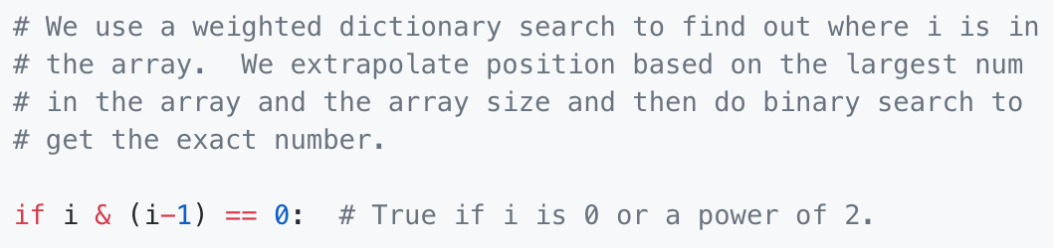
Style Guide Highlights
Docstrings
Inline comments
Do: Explain tricky parts of the code. If you’ll have to explain it at the next code review, use a comment now.
Don’t: describe the code. Assume the person reading the code knows Python (though not what you're trying to do) better than you do.

Slide 21
Style Guide Highlights
Docstrings
Inline comments
Good code speaks for itself
No need to write separate documentation.
No need to for author to explain what’s going on.
Public domain

Slide 22
Code Style in the Bootcamp

Slide 23
Code Style in the Bootcamp
Jupyter
Jupyter is our main tool for teaching and sharing code.
Jupyter makes it difficult to use code style tools.
Recommendations:
Pylint doesn’t work, though nblint is a command line stand in.
Jupyter extensions includes two beautifiers.
nasa

Slide 24
Code Style in the Bootcamp
Jupyter
Jupyter vs External code
Use Jupyter for tying together a workflow in an an easy to read format.
Use external code for writing complex functions that you will call from Jupyter.
nasa

Slide 25
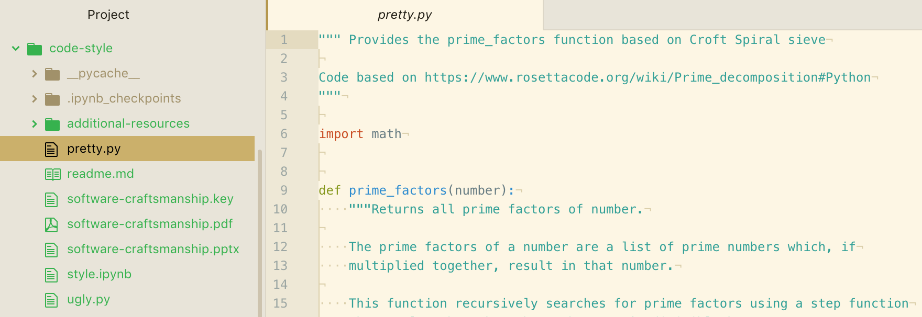
Code Style in the Bootcamp
Jupyter
Jupyter vs External code
External code
If a function you’re writing is > 10 lines, consider breaking it out into an external .py file.

Slide 26
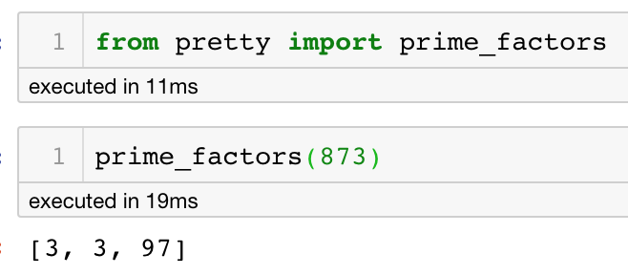
Code Style in the Bootcamp
Jupyter
External code
If a function you’re writing is > 10 lines, consider breaking it out into an external .py file.
Then you can import it to your Jupyter notebook

Slide 27
Write good code

Slide 28
Write good code
Code is for communication
Use a style guide and style tools
Find a balance between Jupyter and external code
Good code speaks for itself

